Slide 1

HighSpeedSMS
Bulk SMS Solutions

Slide 2
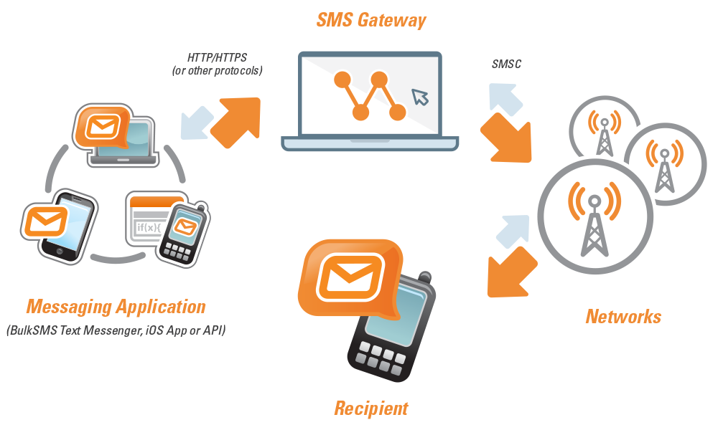





About HighSpeedSMS
Service of Bonrix Software Systems - Leading IT solutions provider
End-to-end messaging platform with complete integration solutions
Customized SMS solutions for various industries and business needs
Multi-network support - GSM/GPRS, CDMA and 3G networks
Cost-effective messaging for businesses of all sizes

Slide 3






Our Services
Bulk SMS
VoiceCall
WebSMS API
Large volume messaging for alerts, reminders, and marketing campaigns
Pre-recorded voice messages to mobile and landline networks
Delivery receipts, custom sender IDs, and real-time reporting
Bulk SMS via Modem
Multi-Language Support
Flexible Solutions
Direct SMS sending through GSM modems and mobile devices
Send SMS in Gujarati, Hindi, English, and other languages
Upgrade or downgrade plans anytime based on your needs

Slide 4






Benefits of SMS Communication
Fast & Simple
Economical and quickest way to communicate with mobile contacts
Build Relationships
Personalized messages help connect with customers and staff
Save Time
Reduces time-consuming processes like outbound calling
Reduce No-Shows
SMS reminders can reduce no-shows by up to 80%
Cost-Effective
Fraction of the cost of other channels with productivity gains

Slide 5










Industries We Serve
Sales & Marketing
Information Technology
Health Care
Financial Institutions
Educational Institutes
Hotel Industry
Real Estate
Advertising
Travel & Tourism

Slide 6






Technical Expertise & Support
Expert Integration Advice
Viability and compatibility guidance for SMS facility integration
Ongoing Support
Continuous updates to match evolving technology trends
In-House Development
Products exclusively developed by our expert team
Customization
Tailored solutions to suit specific business requirements
End-to-End Platform
Complete solution from back-end integration to application hosting

Slide 7
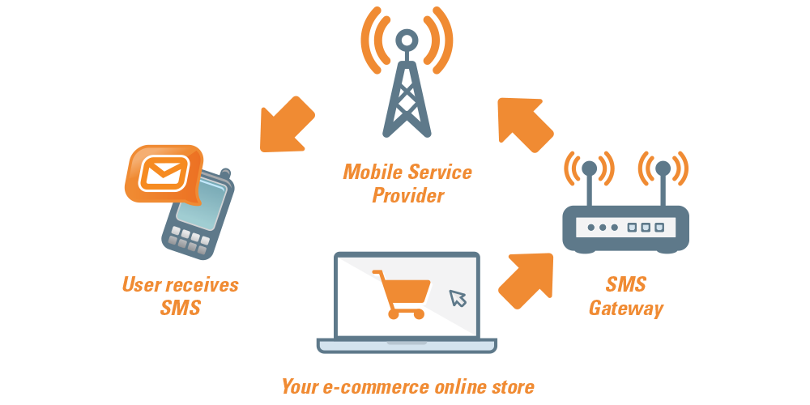


Contact Us
Email
info@bonrix.net
bonrix@gmail.com
Phone
+91-9429045500
HighSpeedSMS is a service of Bonrix Software Systems

